Slide 1

Modeling and circuit design for three-terminal memristors
presented by:
K ASHRITH - 2021CSB066
TARUN CHANDRA - 2021CSB118

Slide 2
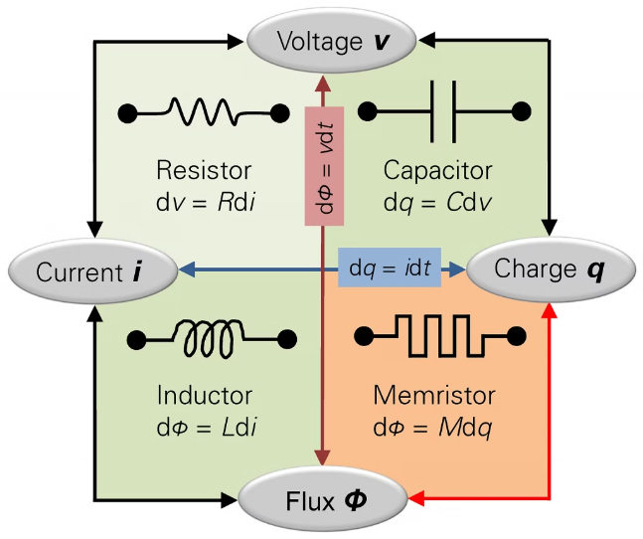
INTRODUCTION TO MEMRISTORS
A memristor is an electrical component that limits or regulates the flow of electrical current in a circuit and remembers the amount of charge that has previously flowed through it.
Memristors are important because they are non-volatile, meaning that they retain memory without power
Memristor can be used as associative memories. These memories map an input pattern to an output one according to the similarities of the input pattern to the pattern stored in the memory..

Slide 3
Memristor properties and characteristics
Memristors are resistive devices that can "remember" their resistance state, even when power is removed.
Their resistance depends on the history of the voltage/current applied, exhibiting a hysteresis loop in their characteristics.
Memristors can be programmed to different resistance states by applying appropriate voltages, enabling non-volatile memory and logic functions.

Slide 4

THREE TERMINAL MEMRISTOR
a three-terminal memristor model is developed in order to improve the anti-interference performance of the memristor and address the issue that the resistance value of the conventional two-terminal memristor is readily impacted by voltage.
The memristor offers the benefits of low power consumption, compact size, and great integratability as a nanoscale device.

Slide 5
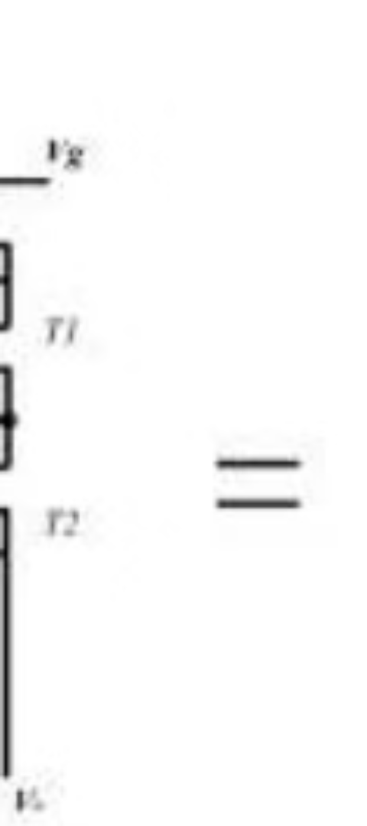
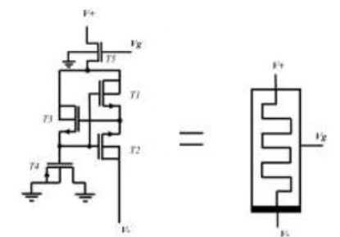
THREE-TERMINAL MEMRISTOR MODEL DESIGN
1
The source and drain terminals of the T4 transistor are grounded, so T4 transistor can be seen as a capacitor to provide storage memory function for the entire circuit
2
T5 acts as the input control of memristors.
3
T1 and T2 transistors are driven by the input conduction voltage and can be seen as two nonlinear resistors.
4
T3 transistor acts as a regulating switch to regulate the charging and discharging of the capacitor to change the resistance value of T1 and T2.

Slide 6
SIMULATION OF THREE-TERMINAL MEMRISTOR CIRCUIT
1.Utilizing simulation software such as SPICE (Simulation Program with Integrated Circuit Emphasis) or other specialized circuit simulation tools to simulate the behavior of the three-terminal memristor circuit.
2.Generating input signals to apply to the circuit and observing the output response. This involves setting up the simulation with appropriate input voltage or current sources to study the memristor's behavior under different conditions.
3.Analyzing the simulation results to understand the behavior of the three-terminal memristor circuit. This includes studying the relationship between input and output signals, observing changes in resistance, and exploring the circuit's dynamic properties.
4.Ensure that the simulation setup includes appropriate boundary conditions and initial conditions for the memristor's state variables, such as w, to accurately reflect the expected behavior of the circuit.

Slide 7
A three-terminal memristor vs traditional two-terminal memristors.
1
Three-terminal memristors, have an additional terminal that allows for direct control of the internal state variable, such as the "write" operation in addition to the "read" operation. This allows for more sophisticated operations and functionalities compared to two-terminal memristors, which lack this direct control.
2
Three-terminal memristors are often used in neuromorphic computing and artificial synapse applications due to their additional control terminal, which can enable more complex synaptic behaviors. Two-terminal memristors are more commonly used in simpler memory applications, such as non-volatile memory.
3
Three-terminal memristors are more complex in terms of design and fabrication compared to two-terminal memristors.which can affect the scalability and cost of production.
4
Three-terminal memristors offer more precise control over the resistance states compared to two-terminal memristors.

Slide 8



Challenges in Memristor Modeling and Design
Integrating three-terminal memristors into existing circuit architectures and systems can be challenging. Compatibility with standard CMOS processes, signal compatibility, and interface requirements need to be carefully considered.
Three-terminal memristors may exhibit non-linear and volatile behavior, requiring careful design considerations to ensure reliability and stability over time and under varying operating conditions.
Designing circuits with three-terminal memristors can be more complex compared to traditional circuits due to the additional control terminal.

Slide 9
SUMMARY
In summary, three-terminal memristors represent an intriguing area of research, bridging the gap between traditional memristors and more complex electronic systems. Their ability to exhibit both conservative and non-conservative behavior opens up new avenues for innovation in electronics and computational systems .Careful design and integration strategies are necessary to harness the full potential of three-terminal memristors in future computing systems.

Slide 10
Thank You

